Slide 1
Unreal conditions
22. Second conditional

Slide 2


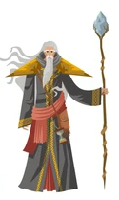

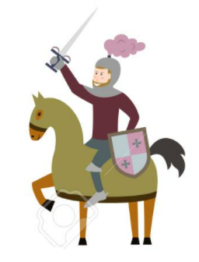
Fantasy and professions
What would you be if you were not a/an (your profession)?
What would you do if you were in a fantasy world?

Slide 3
Second conditional
We talk about hypothetical situations. The verb in the conditional clause is in the past tense, yet the meaning of the sentence is in the present or future.
conditional clause (if + Past Simple) + result clause (would + base form of the verb).
If she had a car, she would drive to work.
We sometimes use could instead of would.
If we had more time, we would exercise more.
If we won the lottery, we could buy a new car.
Notes:
Check video https://www.youtube.com/watch?v=iZnL2cb_w20

Slide 4
Choose the correct one
If you changed / change one thing about yourself, what would it be / it would be?
If a guy wouldn’t call / didn’t call you after a date, would you be / were you angry?
How would you react / did you react if someone gave / gives you a compliment?
If you would win / won a million dollars, how you spent / would you spend it?
Who would you take / did you take to a party if you had / would have a choice?
If you celebrated / would celebrate an important birthday, what was / would be your ideal gift?
If you found / find someone’s bag on the sidewalk, would you try / did you try to return it to the owner?
If I would ask / asked your best friend to describe you, which word would he choose / did he choose?
Who you asked / would you ask for help, if you needed to solve / would solve a problem?
If you could have / had to choose, could you prefer / would you prefer a trip to South America or the Far East?
Notes:
Past + would + verb in base form
If you changed one thing about yourself, what would it be?
If a guy didn’t call you after a date, would you beangry?
How would you react if someone gave you a compliment?
If you won a million dollars, how would you spend it?
Who would you take to a party if you had a choice?
If you celebrated an important birthday, what would be your ideal gift?
If you found someone’s bag on the sidewalk, would you try to return it to the owner?
If I asked your best friend to describe you, which word would he choose?
Who would you ask for help, if you needed to solve a problem?
If you had to choose, would you prefer a trip to South America or the Far East?

Slide 5
Second conditional, were
In formal English, were is used as a form of the verb to be in the conditional clause. It is also used in the phrase If I were you, ... .
If it were colder, I would go inside.
If I were older, I would get the job.
If I were you, I would buy a new car
Negative
If I weren’t a teacher, I would be an accountant.
If I weren’t an engineer, I would be a doctor.

Slide 6
Complete the sentences
1. If I were a scientist, I ______ (not be) very happy.
2. ______ I ______ (be) rich if I were a store owner?
3. You ______ (be) an accountant if you were good with numbers.
4. If we were rich, we ______ (hire) a pilot to fly us around the world.
5. I would be a film director if I ______ (be) more creative.
6. If they were in the right profession, they ______ (not be) so unhappy.
7. If you weren’t an architect, what ___ you ___ (be)?
8. Pete ______ (follow) his dream if he weren’t so afraid to try.
9. If Susan and John ______ (be) younger, they would choose a different profession.
10. If Susan and Marco ______ (not be) still in cooking school, they would open their own restaurant.
Notes:
Would not be
Would, be
Would be
Would hire
Were
Would not be
Would you be
Would follow
Were
Were not

Slide 7
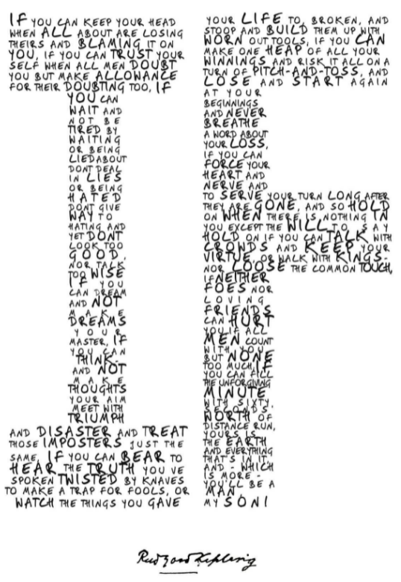
Ask one of your friends
If I had the time, I would ____.
If I were very fit, ____.
If a salesperson gave me too much money back, ____.
If I had to go to a party where I didn’t know anyone, ____.
If I had a two-month vacation, ____.
If I were looking for a new job, ____.
If I had to buy a gift for a close friend, ____.
If I were celebrating my birthday tonight, ____.
If I had to move, ____.
If I could change one thing about my home, ____.
If I could change one thing about my life, ____.
If I had to describe myself in one word, ____.
If I were an animal, ____.

Slide 8
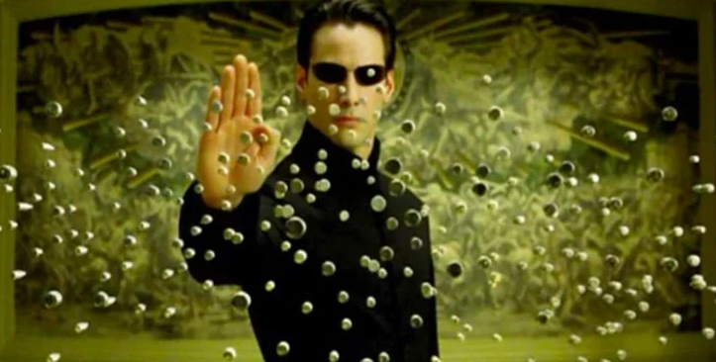
Kahoot time!
Structure
If + PAST + would / could + verb in base form
Go to kahoot.it
Enter the Game PIN.
Enter your name.
Get ready for battle.
Notes:
https://create.kahoot.it/details/41d06a25-6688-440c-8e0d-33a551533a6e

